Slide 1

What You Need to Know About Air Quality at Home
Hong Zhang

Slide 2
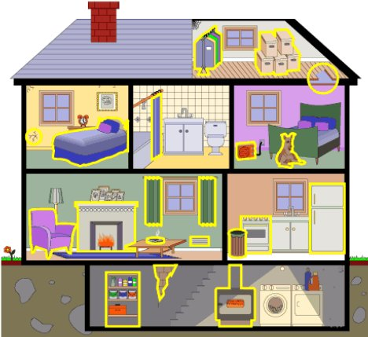
What is Indoor Air Quality (IAQ)?
Indoor Air Quality is the relative health of the air in an indoor environment, good or bad
Good IAQ-- Minimal levels of indoor pollutants such as odors / fumes and particulates such as dust and pollens
Poor IAQ-- Fumes, odors or particulates
in excessive concentrations that may
affect the health of the occupants

Slide 3
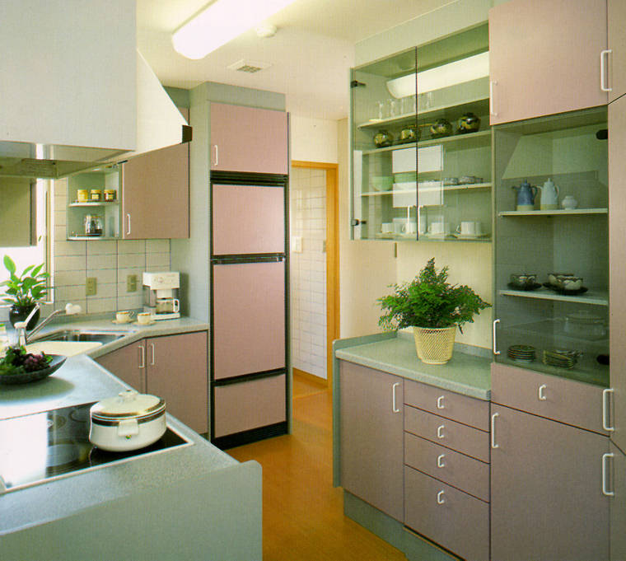
Common Air Quality Problems
In Each Room In Your Home
In The Kitchen:
Moisture in the kitchen can be a source of mould and odours
Gas stoves or ovens release carbon monoxide, nitrogen oxides, and particulates
Pressed wood cupboards contain formaldehyde and can cause
illness or irritation
Cleaning products often
contain harsh chemicals that
can be inhaled

Slide 4

Common Air Quality Problems
In Each Room In Your Home
In The Living Room:
New carpets can be a source of formaldehyde
Old carpets are a major source of dust, mold, and allergens, such as pet dander
Candles and incense can release lead and volatile organic compounds (VOCs), including particulate matter
Smoking releases toxic
chemicals and gases that get
trapped in the carpet, drapes,
and furniture

Slide 5
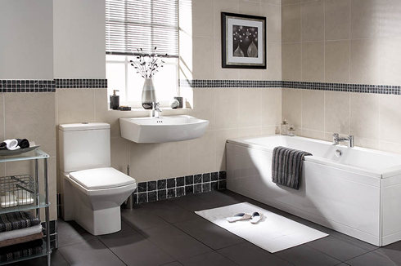
Common Air Quality Problems
In Each Room In Your Home
In The Bathroom:
Moisture and humidity from the shower can lead to mould
Chemical aerosols from personal care products and air fresheners
Many potentially harmful
cleaning products are kept
under the sink – check the
labels

Slide 6
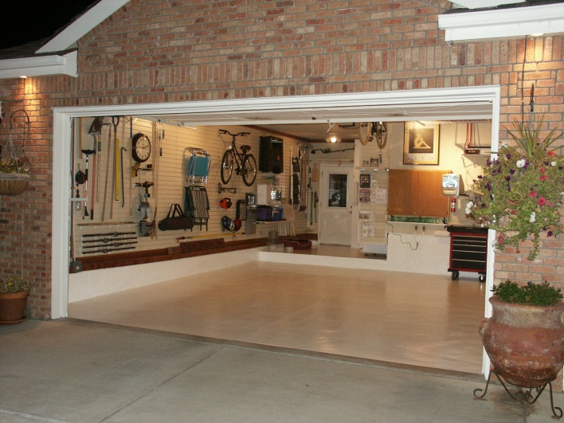
Common Air Quality Problems
In Each Room In Your Home
In The Garage:
Car exhaust contains a host of chemicals and gases that can get into the house; don't run your car in the garage
Leaky gasoline containers can produce intoxicating or nauseating fumes
Improper storage of old paint
cans or pesticides can release
toxics and volatile organic
compounds (VOCs)

Slide 7
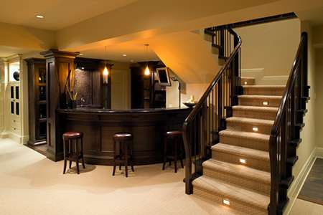
Common Air Quality Problems
In Each Room In Your Home
In The Basement:
Oil and gas furnaces can release carbon monoxide, if not properly maintained
Stored paint cans and solvents are a prime source of VOC's
Cracked foundations can
lead to a build up of radon
in some homes
Leaky foundations can
lead to mould and other
biological contaminants

Slide 8
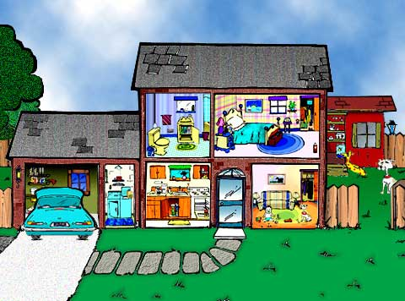
Five Simple Steps to Improve Indoor Air Quality
Keep your floors clean
Keep a healthy level of humidity (30%-50%)
Make your home a no-smoking zone
Test for radon
Smell good naturally

